Slide 1
Phase field Equations
Methodology

Slide 2
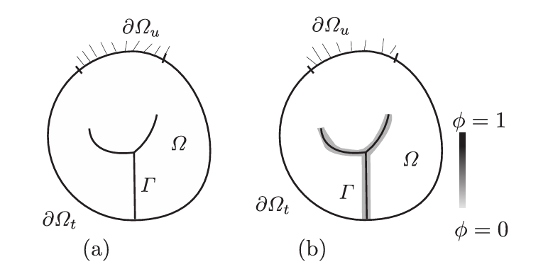


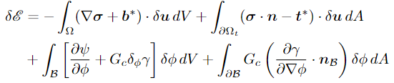

Variational Problem
Fig 1. A solid body Ω with a crack Γ approximated by diffused parameter φ
Total energy functional E in a quasi-static loading regime
Addition of Phase-field parameter φ

Slide 3
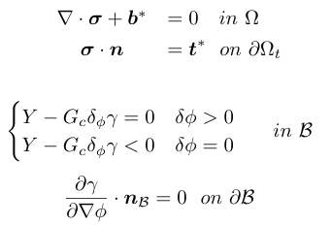





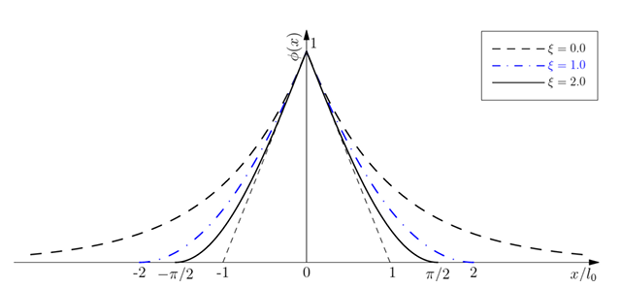

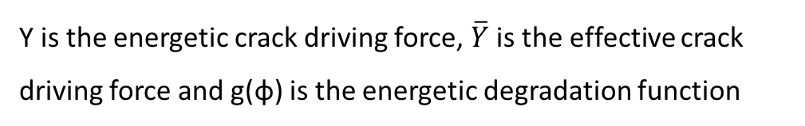
Governing differential equation in Strong form
Commonly used
Y is the energetic crack driving force, $\overline{Y}$ is the effective crack driving force and g(φ) is the energetic degradation function
L₀ is known as the length scale parameter
Fig 2. Variation of φ on considering different geometric crack functions α(φ)

Slide 4


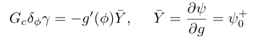





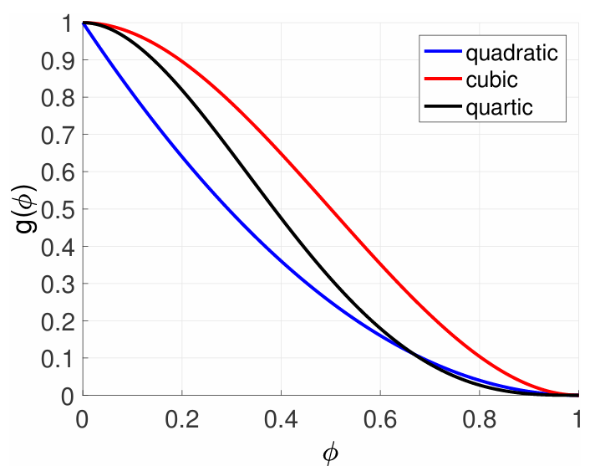
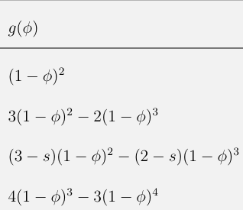



Effective crack driving force and energetic degradation function
Isotropic model with no split
Deviatoric Strain Energy model
Strain splitting model
Stress splitting model
commonly used
Fig 3. Different energetic degradation functions
Fig 4. Plots of different energetic degradation functions

Slide 5


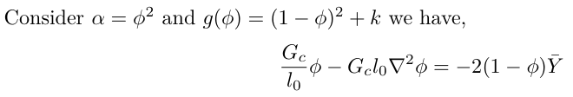
Problem formulation
  Step 1: Define geometry (Mesh), material properties, boundary conditions, and initial conditions(if exist like predefined crack)
  Step 2: Apply the load ( for a quasi-static problem time can be used as a load parameter especially while coding)
  Step 3: Define governing differential equations
  Step 4: The coupled partial differential equations can now be solved using a staggered scheme or any other method as provided
  Note: The above analysis is for quasi-static problems only, for dynamic problems, we will get velocity field and damage rate field terms also in RHS

